Slide 1
Spherical Mirrors
CHAPTER 10:part 2

Slide 2
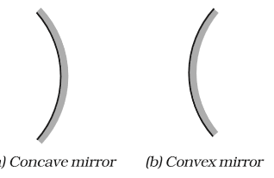
Spherical Mirrors
CONVEX
.
CONCAVE
Notes:
Spherical mirrors are those mirrors whose surfaces are curved either inwards or outwards.
A spoon is also a spherical mirror.
There are two types of spherical mirrors;concave and convex mirrors.
1.Concave mirrors or converging mirrors, are mirrors which have a reflecting surface that bulges inwards and converges the light to one point.
2.Convex mirrors are mirrors where the reflective surface bulges outwards in the direction of the light source and the light appears to diverges outwards from a point.

Slide 3
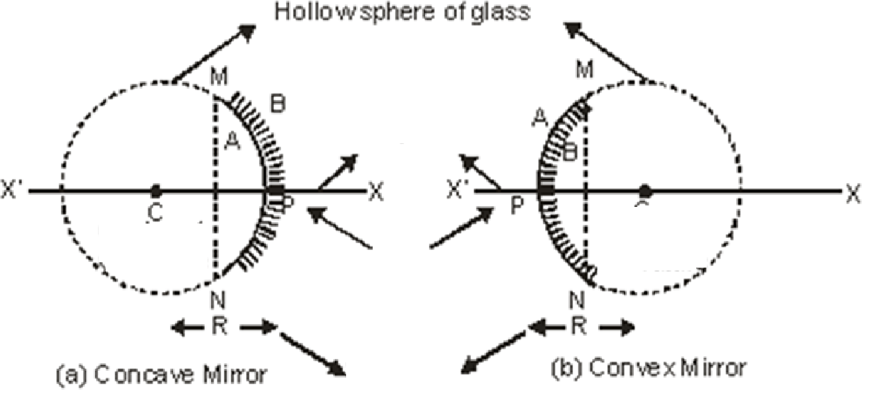
Few Basic terms related to Spherial Mirror
Principal axis
Pole
Aperture(A)
Centre of curvature
Radius of curvature :
Focus point :
Focal length : PF = f
f=R/2.
Aperture
Principal axis
Center of curvature
Pole
Radius of curvature
Notes:
Let us now look into a few basic terms related to spherical mirrors.
Take a look at the diagram as we discuss through the terms.
Principal axis : It is the Line joining the pole and center of curvature of the spherical mirror.
The Pole is the geometrical central point of the reflecting spherical surface or the aperture, and is denoted by (P).
Aperture is the width of reflecting spherical surface.
Centre of curvature is the center of the hollow glass sphere of which the spherical mirror is a part of is called center of curvature.
Radius of curvature is the distance between the pole and the centre of curvature. i.e. PC = R or The radius of the hollow sphere of which the mirror is a part.
Focus point is that point on the principal axis, where all parallel rays meet after reflection is called as Principal Focus or Focus. It is denoted by letter ‘F’.
Focal length is the distance between the pole and focus point i.e. PF = f.
We will see focus point
The relationship between focal length and Radius of curvature is given by F=R/2 where R is the Radius of curvature.

Slide 4
Image Formation by Spherical Mirror
Rule 1:Ray of light parallel to principle axis.
Rule 2:A ray of light which passes through centre of curvature.
Notes:
Let us now look into Image formulation by spherical mirrors.
Rule one states that a ray of light which is parallel to the principle axis always passes through focus (meet at focus) or vice-versa.
From the figure given above it can be clearly seen that the light rays are parallel to the principle axis,then this ray always passes through the focus incase of concave mirrors and appears to diverge from principle focus in case of concave mirrors. This can be seen from the diagrams above.
Rule 2 states that :A ray of light which passes through the centre of curvature also known as normal at the point of incidence on spherical mirror will retrace its path after reflection.It is reflected back along the same path.

Slide 5
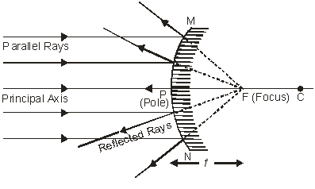
Image Formation by Spherical Mirror
Rule 3: A ray of light falling directly on pole will get reflected with the same angle on the other side of principal axis.
Rule 4:A ray passing through principle focus.
Notes:
The third rule says that a ray of light falling directly on pole will get reflected with the same angle on the other side of principal axis.
And finally the fourth rule states that A ray passing through principle focus of a concave mirror or a ray which is directed towards the principal focus of a convex mirror, becomes parallel to the principle axis after reflection

Slide 6
Image Formation by CONCAVE Mirror
Object at infinity
Object between infinity and centre of curvature (C)
Object at centre of curvature (C)
Object between centre of curvature (C) and Principal focus (F)
Object at Principal Focus (F)
Object between Principal Focus (F) and Pole (P)
Notes:
The images formed by concave mirrors consist of six diagram.They are:
Object at infinity
Object between infinity and Centre of Curvature
Object at Centre of Curvature (C)
Object between Centre of curvature (C) and Principal Focus (F)
Object at Principal Focus (F)
Object between Principal Focus (F) and Pole (P)
In the following slide we will go through them one by one.

Slide 7
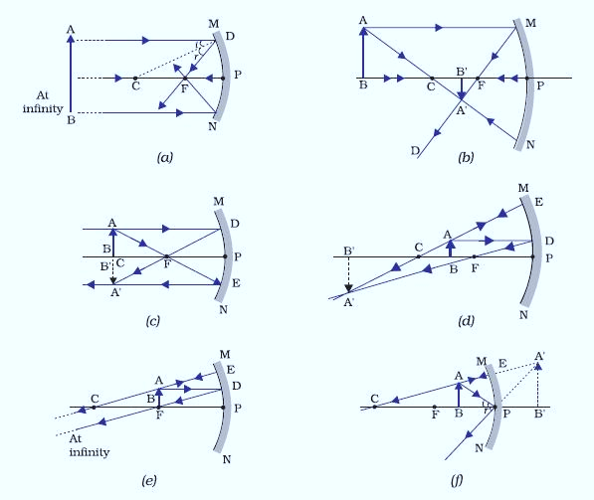
Ray diagrams for concave spherical mirrors
Notes:
Look into the diagram given as we discuss each of them.
Figure (a) shows the
Object at infinity:
Parallel rays coming from the object towards the mirror ,after reflection converge at principal focus F of a concave mirror; Hence, when the object is at infinity the image will form at F.
This image is Point sized,Highly diminished ,Real and inverted.
Figure (b) shows
Object between infinity and Centre of Curvature:
When object is placed between infinity and centre of curvature of a concave mirror the image is formed between centre of curvature (C) and focus (F).The properties of this image include it being Diminished compared to the object, Real and inverted.
Figure (c)
Object at Centre of Curvature (C):
When the object is placed at centre of curvature (C) of a concave mirror, a real and inverted image is formed at the same position.
Properties are that the image is the Same size as object,Real and inverted.
Figure (d) shows:
Object between Centre of curvature (C) and Principal Focus (F):
When the object is placed between centre of curvature and principal focus of concave mirror, a real image is formed beyond the centre of curvature (C).
Image is Larger than object,Real and inverted.
Figure (e) showss
Object at Principal Focus (F):
When the object is placed at principal focus (F) of a concave mirror, a highly enlarged image is formed at infinity.This image is Highly enlarged,Real and inverted.
Figure (f) shows:
Object between Principal Focus (F) and Pole (P):
When the object is placed between principal focus and pole of a concave mirror, an enlarged, virtual and erect image is formed behind the mirror.
This image is Enlarged
Virtual and erect.
It is important to remember these properties in order to draw the ray diagrams easily.
Let us now talk about some of the uses of concave mirror.
Some of the uses of concave mirrors are: Concave mirrors are commonly used in torches, search-lights and vehicles headlights to get powerful parallel beams of light. They are often used as shaving mirrors to see a larger image of the face. The dentists use concave mirrors to see large images of the teeth of patients. Large concave mirrors are used to concentrate sunlight to produce heat in solar furnaces.

Slide 8
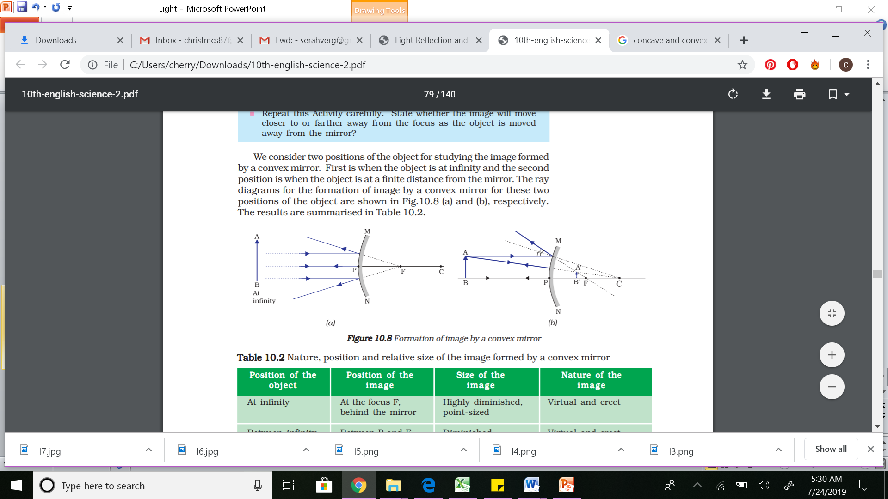
Image formation by Convex Mirror
First position is when the object is at infinity and the second position is when the object is at a finite distance from the mirror.
Notes:
Coming to the next topic which is concave mirrors:
When the object is placed at infinity or at any finite distance from the mirror,the image formed is always diminished ,upright and virtual.
The image will always be formed between the pole and the focus.
Some of the uses of convex mirror are rear-view (wing) mirrors in vehicles. These mirrors are fitted on the sides of the vehicle, enabling the driver to see traffic behind him/her to facilitate safe driving. Convex mirrors are preferred because they always give an erect, though diminished, image. Also, they have a wider field of view as they are curved outwards. Thus, convex mirrors enable the driver to view much larger area than would be possible with a plane mirror.

Slide 9
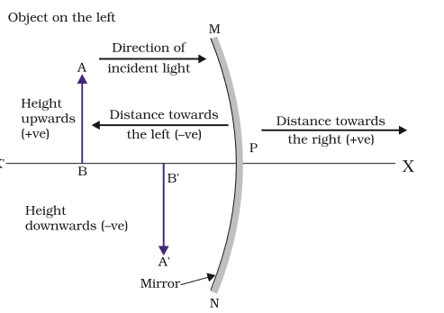
Sign Convention for Reflection by Spherical Mirror
Notes:
According to sign convention,the distance of the object (AB) is negative if the object lies on the left hand side of the mirror.
The distance (B’P)of the real inverted image formed by the mirror is considered negative.
If the image is formed behind the mirror, then the virtual image will be upright and is taken as positive.
For an upright object (AB) the size of the object is positive and the size of the image formed after refection its size is negative.This is if the image is a real and inverted image.
If the image formed is a virtual image then the size is positive as the image is always upright for a virtual image.

Slide 10
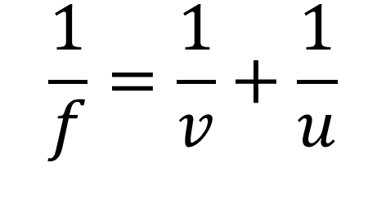
Mirror Formula
f = distance between F and Pole v = distance of image from Pole u= distance of object from Pole R =distance between centre of curvature and pole.
Where F=R/2
$$\frac{1}{f}=\frac{1}{v}+\frac{1}{u}$$
Notes:
The mirror formula for a concave mirror gives the relation between the image distance ‘v’ ,object distance ‘u’ and the focal length ‘f’.

Slide 11

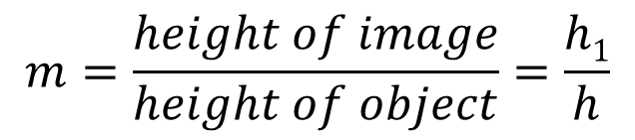

Magnification
$$m=\frac{height of image}{height of object}=\frac{h1}{h}$$
$$m=\frac{−v}{u}$$
We can say that
$$m=\frac{h1}{h}=−\frac{v}{u}$$
If magnifiaciton m>l ---- Image is magnified
m=l ---- Image is of same size
m<1 ---- Image is diminished
Notes:
Linear magnification is defined as the size of the image formed by the mirror to the size of the object .It can also be defined as the ratio of image distance divided by the object distance.
Remember students that the distances and heights used in the above formulae follow sign convention. Hence in the second formula we see a negative ‘v’.
Equate equation 1 and 2 to get the third equation seen above.Depending on the value of m,we can conclude the magnification property of the image.Image is magnified if m>1.
Image is of the same size as the object if m=1.
Image is diminished if m<1.

